Slide 1

Note: The data and information in this document is reflective of a hypothetical situation and client. This document is to be used for KPMG Virtual Internship purposes only.
Sprocket Central Pty Ltd
Ravi Mogili

Slide 2
Note: The data and information in this document is reflective of a hypothetical situation and client. This document is to be used for KPMG Virtual Internship purposes only.
Agenda
Introduction
Data Exploration
Model Development
Interpretation

Slide 3
Note: The data and information in this document is reflective of a hypothetical situation and client. This document is to be used for KPMG Virtual Internship purposes only.
Introduction
Problem Statement:
Sprocket Central Pty Ltd , a medium size bikes & cycling accessories organisation, has given us a new list of 1000 potential customers with their demographics and attributes. (However, these customers do not have prior transaction history with the organisation.)
Our goal:
The marketing team at Sprocket Central Pty Ltd want to know about useful customer insights which could help optimise resource allocation for targeted marketing. Hence, improve performance by focusing on high value customers.
About Dataset:
Sprocket Central Pty Ltd provided us 3 datasets:
Customer Demographic
Customer Addresses
Transactions data
New Customer List (which is the target data)
Steps Taken:
Data Cleaning → Cleaned for better quality
Data Transformation → Merged the transactions, customer demographic, customer address
Data Exploration → Explore the data to reveal insights

Slide 4
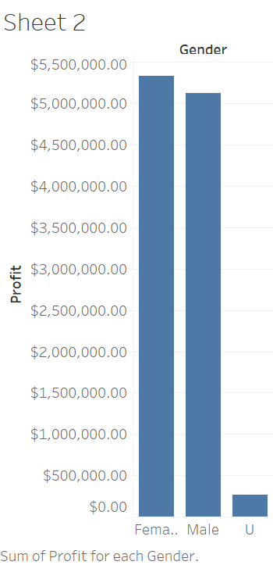
Note: The data and information in this document is reflective of a hypothetical situation and client. This document is to be used for KPMG Virtual Internship purposes only.
Data Exploration
Total Profit based on different Gender
Insights
from the recent transaction history reveal that female customers are the most profitable, generating more than 5 lacs in profit.

Slide 5
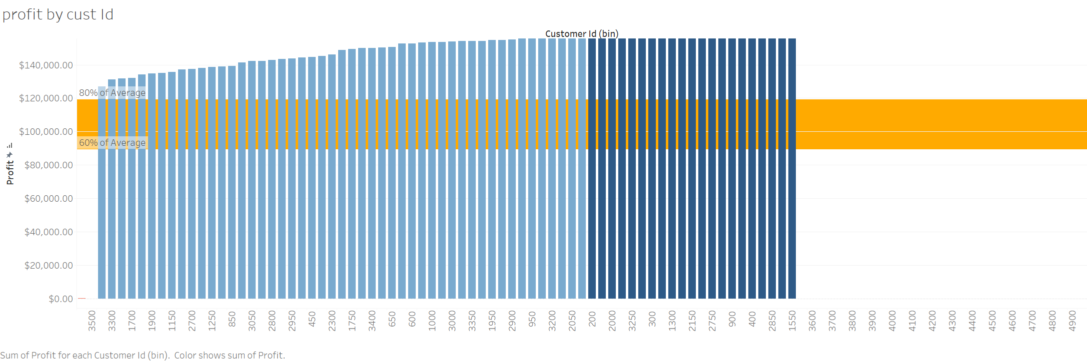
Note: The data and information in this document is reflective of a hypothetical situation and client. This document is to be used for KPMG Virtual Internship purposes only.
Data Exploration
Average Profit in the year 2017 by Gender

Slide 6
Note: The data and information in this document is reflective of a hypothetical situation and client. This document is to be used for KPMG Virtual Internship purposes only.
Data Exploration
Insights:
In the given image, we observe that the average value is $1,088.77, which represents approximately 60% of the data from the customers' ID in our dataset.

Slide 7
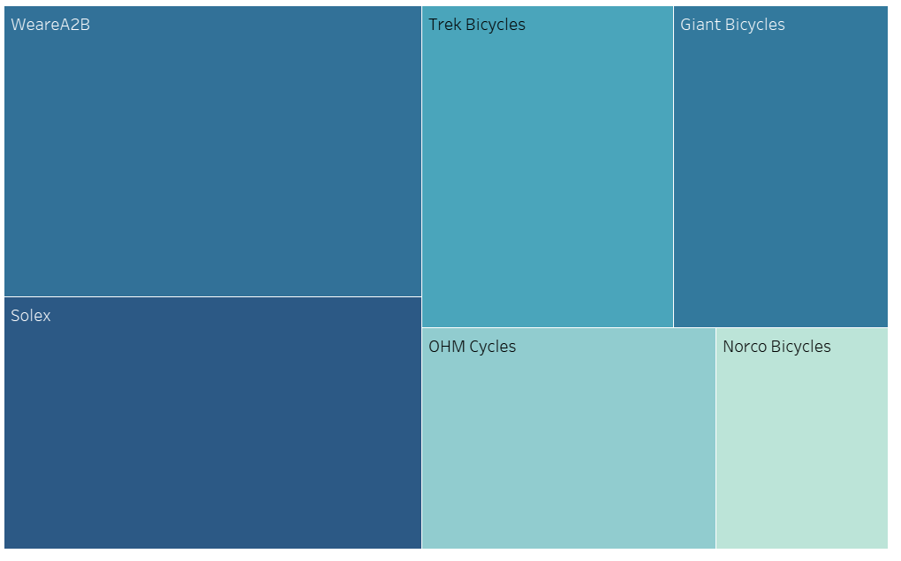
Note: The data and information in this document is reflective of a hypothetical situation and client. This document is to be used for KPMG Virtual Internship purposes only.
Data Exploration
Mostly profitable by Brand
Insights:
Among the various bicycle brands, Narco Bicycle stands out as the least profitable, it was almost experiencing losses in its business. In contrast, other WhareA2b brands have been more successful and profitable.

Slide 8
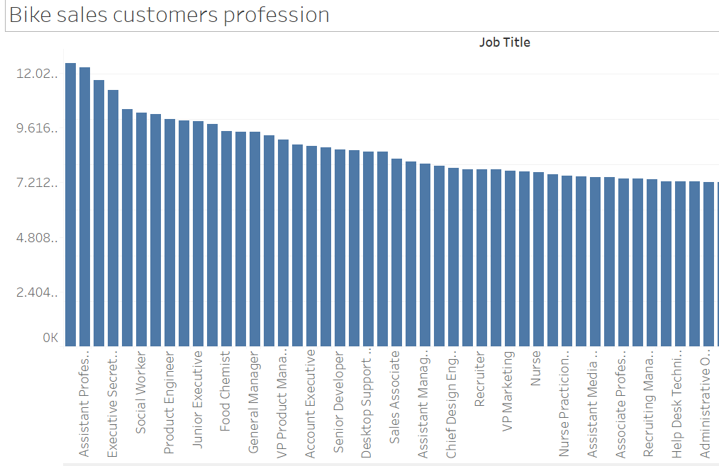
Note: The data and information in this document is reflective of a hypothetical situation and client. This document is to be used for KPMG Virtual Internship purposes only.
Data Exploration
Bike sales by customers procession
Insights:
Bike sales by customers’ procession. Auditors, Ass Professor, and Executive Secretary are mostly buys from last 3 years

Slide 9
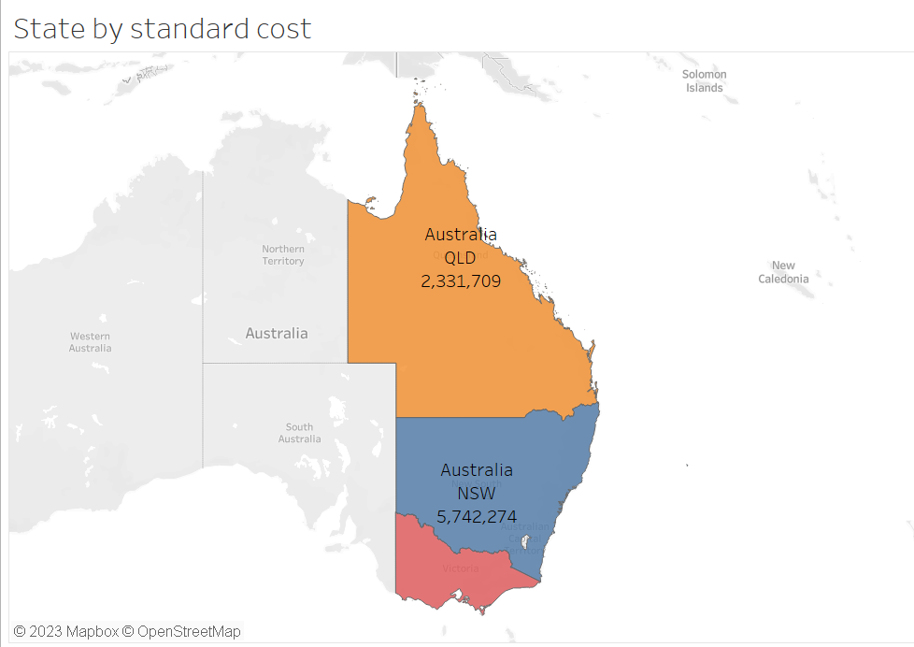
Note: The data and information in this document is reflective of a hypothetical situation and client. This document is to be used for KPMG Virtual Internship purposes only.
Data Exploration
Most purchased products among customers
Insights:
Standard product are most buyable products by customers among the other product with more than 10000 + transactions took place

Slide 10
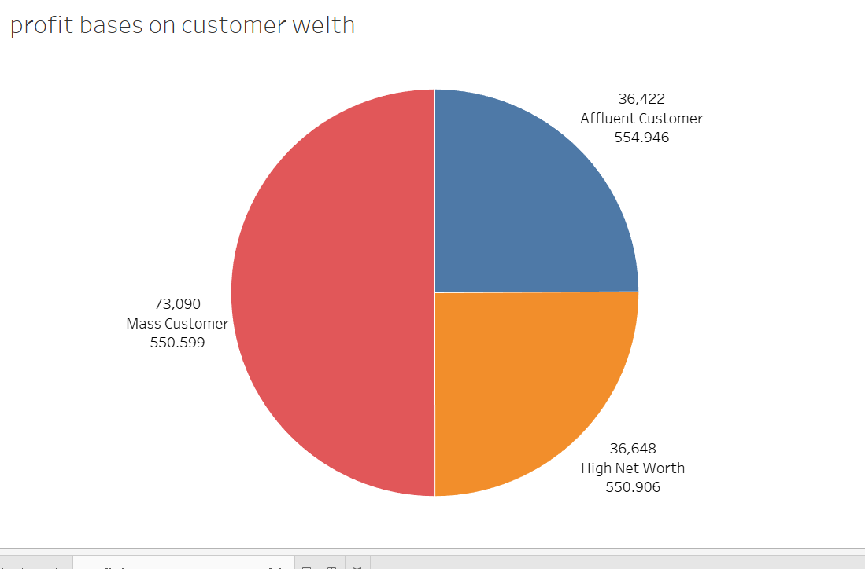
Note: The data and information in this document is reflective of a hypothetical situation and client. This document is to be used for KPMG Virtual Internship purposes only.
Data Exploration
Profit Based on Welth of Customer
Insights:
The data analysis reveals that a significant number of customers have generated good profits it was $550, and a large portion of them made bike purchases in the last 3 years. However, the number of affluent customers, who typically contribute substantially to profits, appears to be comparatively lower.

Slide 11
Note: The data and information in this document is reflective of a hypothetical situation and client. This document is to be used for KPMG Virtual Internship purposes only.
Model Development
Marketing team should deploy the targeted model based on -
Customer between age 30 to 49.
Male customers in the mid-year between April - July and in midweek around Thursday.
Female customers around October and in the start of the weekend, Saturday.
Customers in the Mass Consumer Segment.
Customers related to Financial Services and Manufacturing Industries.
Solex brand and Standard product as the top priority.
Customers living in New South Wales.

Slide 12
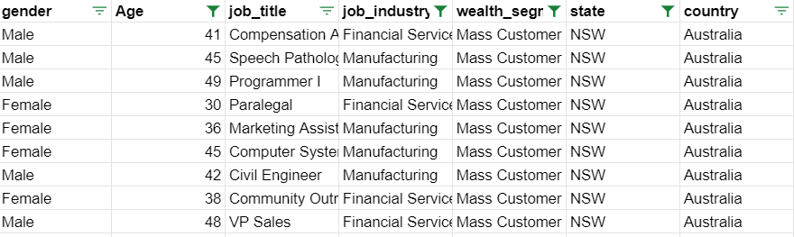
Note: The data and information in this document is reflective of a hypothetical situation and client. This document is to be used for KPMG Virtual Internship purposes only.
Interpretation
After filtering the targeted customers from the New Customer List, it will look like below

Slide 13
Note: The data and information in this document is reflective of a hypothetical situation and client. This document is to be used for KPMG Virtual Internship purposes only.
Appendix
Thank You

